Slide 1
K-Means
Tim Pengajaran
Mata Kuliah Machine Learning
Jurusan Teknologi Informasi Tahun 2021

Slide 2
Disclaimer
This presentation material, including examples, images, references are provided for informational and explanation assistance only
The names of actual products and companies mentioned here in, if any, may be the trademarks of their respective owners
Credits shall be given to the images taken from the open-source and cannot be used for promotional activities

Slide 3
Outline
Clustering
K-means
Evaluating clusters
Image quantization
Clustering to learn features

Slide 4
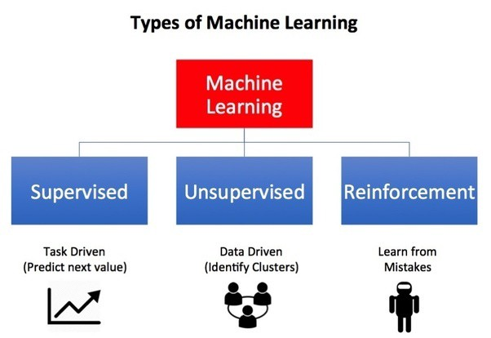
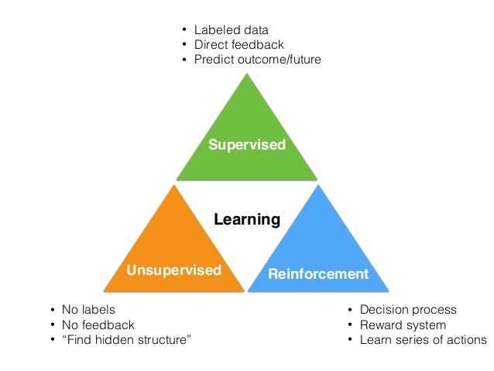
Learning Paradigm

Slide 5
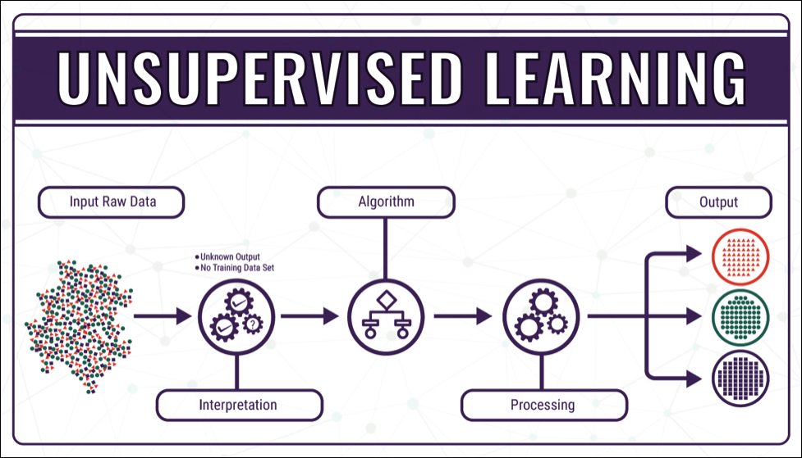
Unsupervised
The goal is to discover hidden structures or patterns in unlabeled training data.
Clustering, or cluster analysis, is the task of grouping observations so that members of the same group, or cluster, are more similar to each other by some metric than they are to members of other clusters.

Slide 6
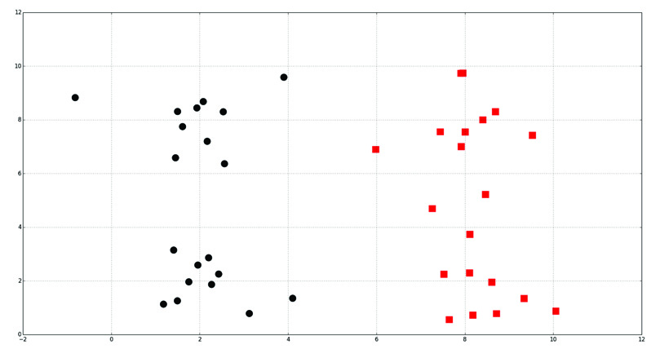
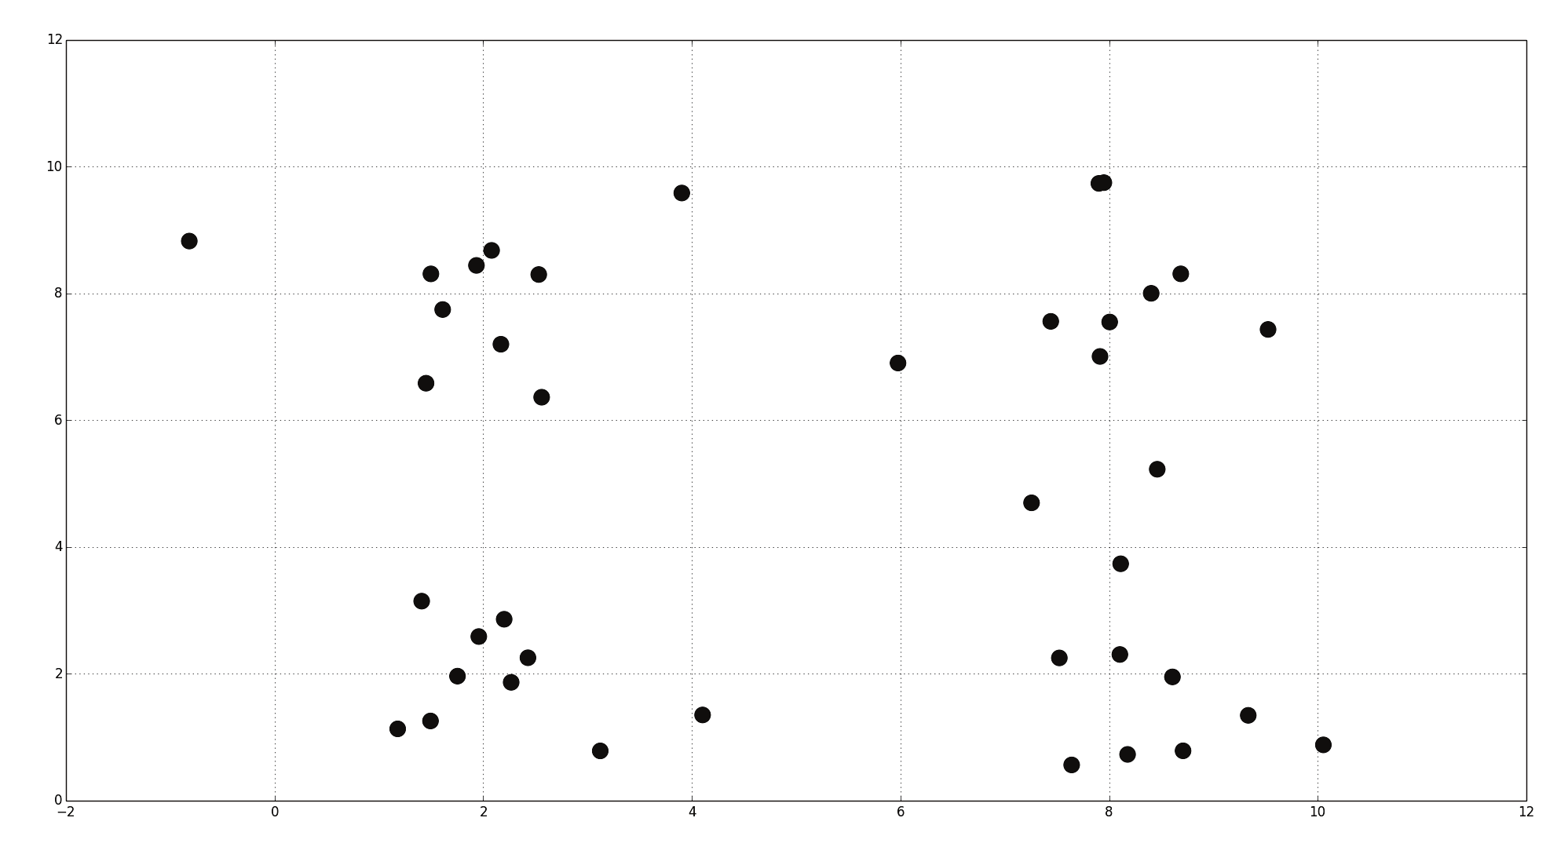
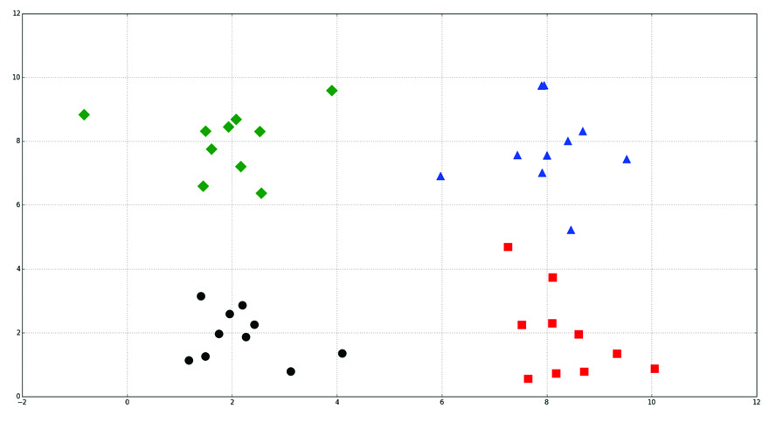
Clustering
2 Clusters
4 Clusters

Slide 7
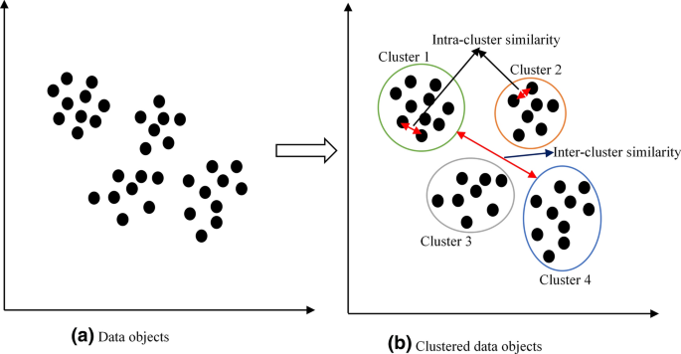
Clustering

Slide 8
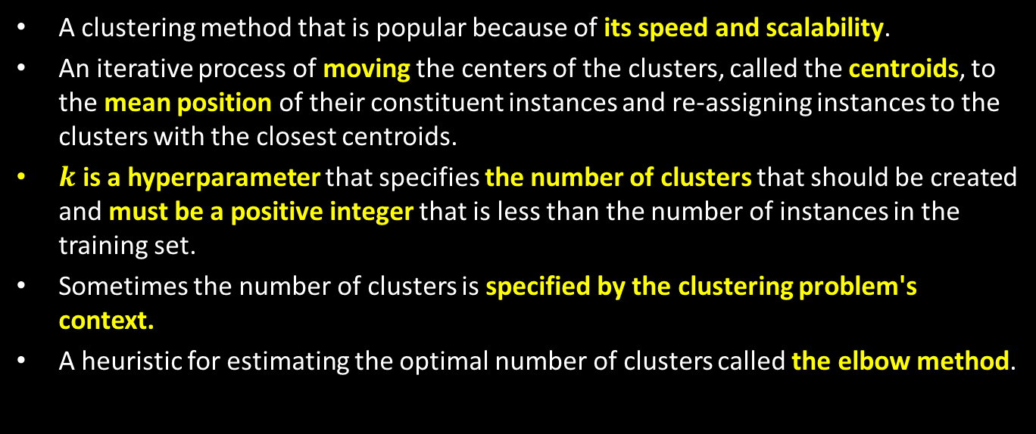
K-Means
A clustering method that is popular because of its speed and scalability.
An iterative process of moving the centers of the clusters, called the centroids, to the mean position of their constituent instances and re-assigning instances to the clusters with the closest centroids.
$k$ is a hyperparameter that specifies the number of clusters that should be created and must be a positive integer that is less than the number of instances in the training set.
Sometimes the number of clusters is specified by the clustering problem's context.
A heuristic for estimating the optimal number of clusters called the elbow method.

Slide 9
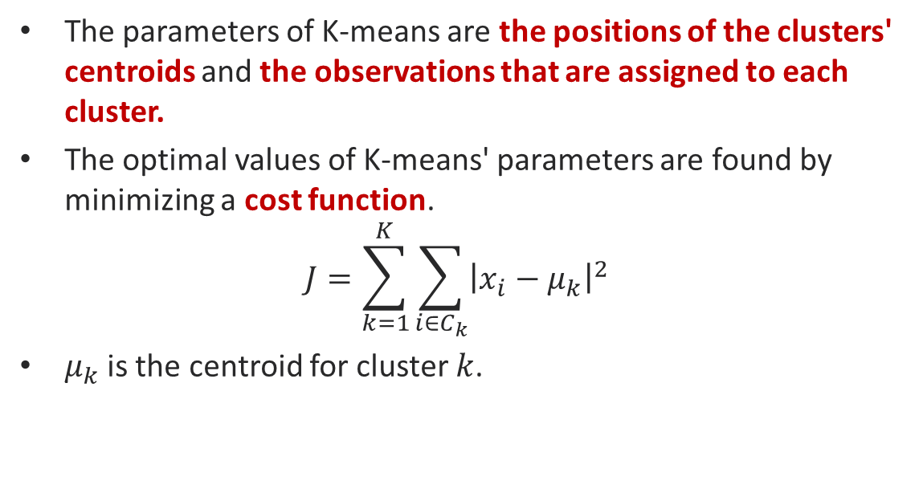
K-Means
The parameters of K-means are the positions of the clusters' centroids and the observations that are assigned to each cluster.
The optimal values of K-means' parameters are found by minimizing a cost function.
$$J=\sum_{k=1}^{K}{\sum_{i∈C_{k}}{{\left|x_{i}−μ_{k}\right|}^{2}}}$$
$μ_{k}$is the centroid for cluster $k$.

Slide 10
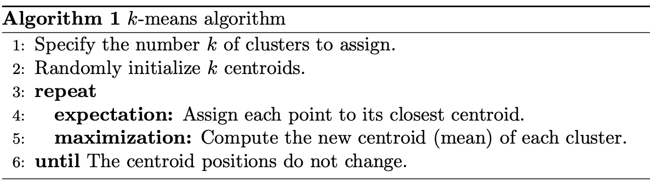
K-Means Algorithm

Slide 11
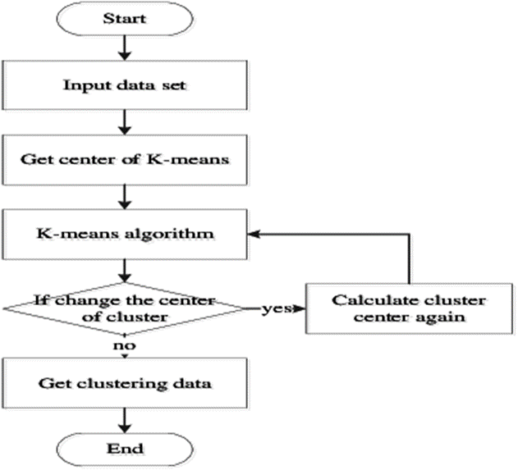
K-Means Flowchart

Slide 12
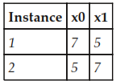
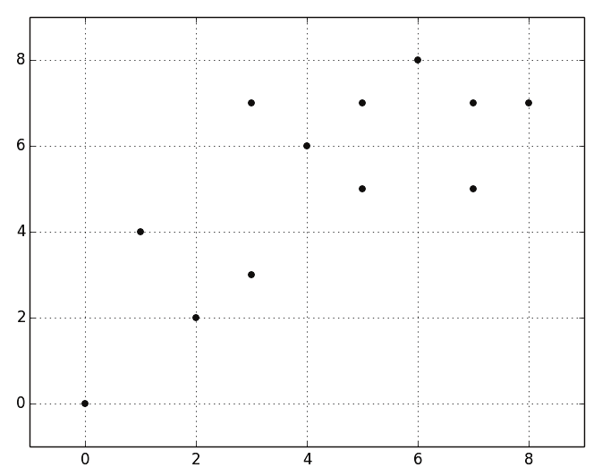
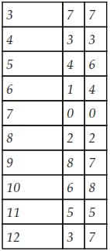
K-Means Example

Slide 13
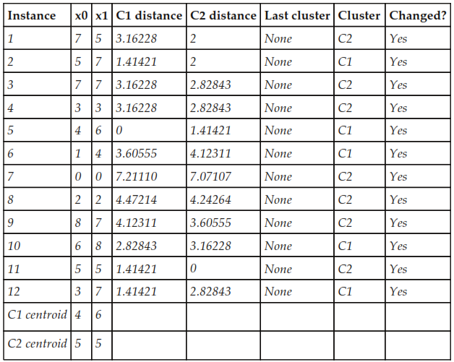
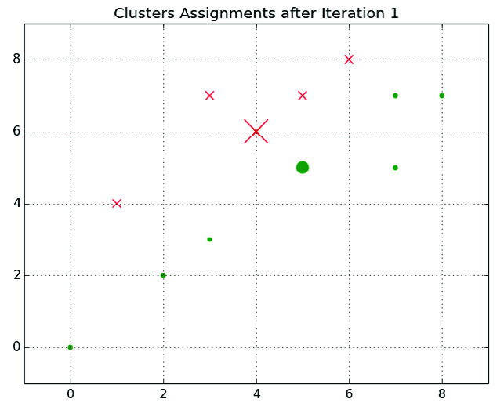
1st Iteration

Slide 14
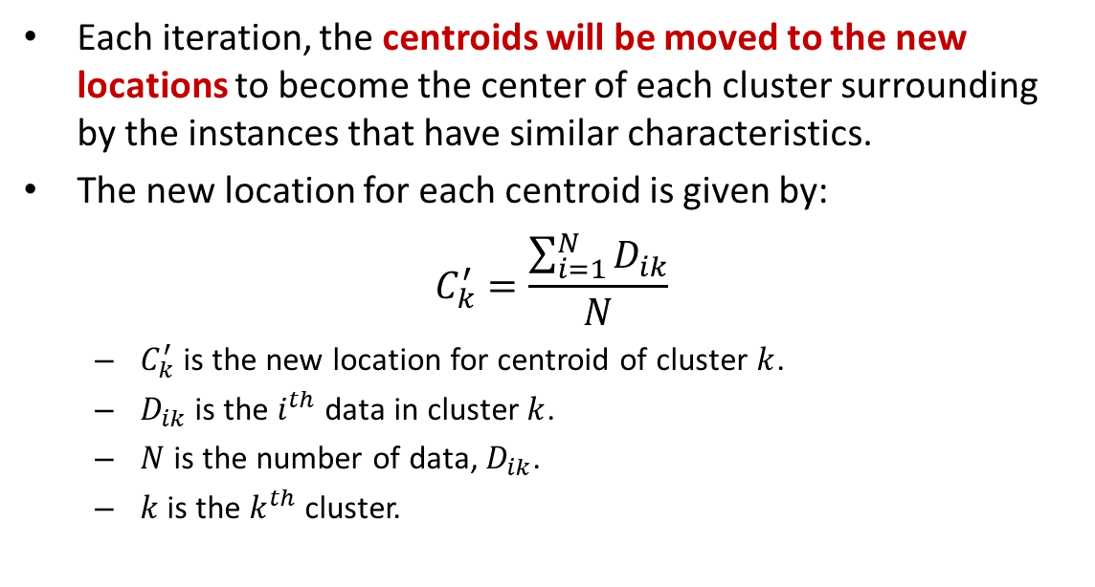
Moving the Centroids
Each iteration, the centroids will be moved to the new locations to become the center of each cluster surrounding by the instances that have similar characteristics.
The new location for each centroid is given by:
$$C_{k}^{′}=\frac{\sum_{i=1}^{N}{D_{ik}}}{N}$$
$C_{k}^{′}$ is the new location for centroid of cluster $k$.
$D_{ik}$ is the $i^{th}$ data in cluster $k$.
$N$ is the number of data, $D_{ik}$.
$k$is the $k^{th}$ cluster.

Slide 15
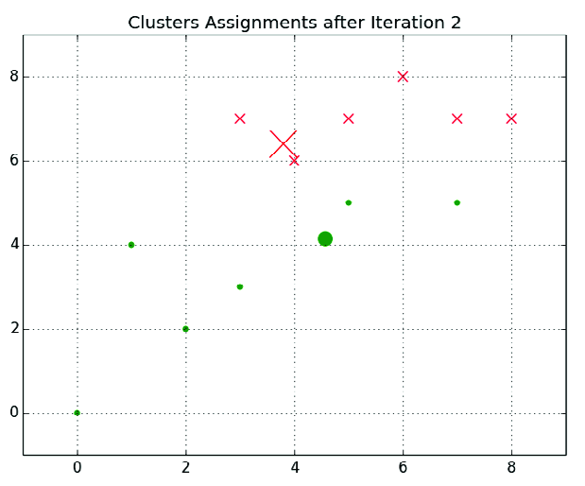
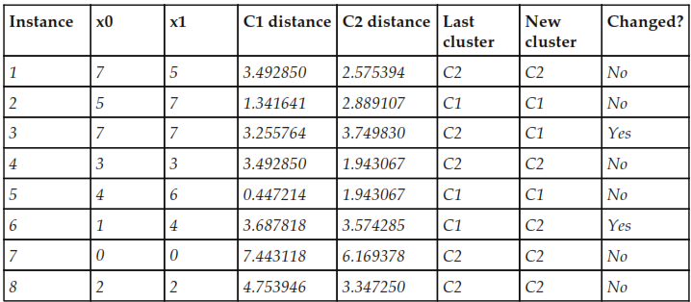
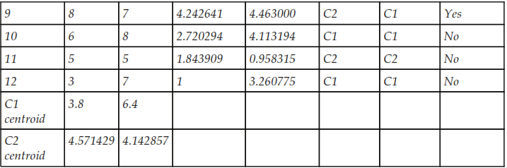
2nd Iteration

Slide 16
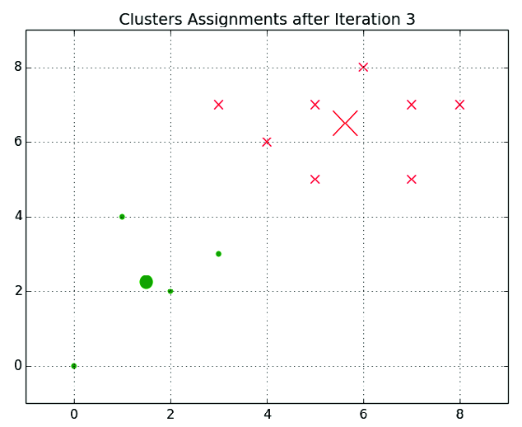
3rd Iteration
k-means will continue iterating until some stopping criteria is satisfied.
This criteria is either a threshold for the difference between the values of the cost function for subsequent iterations, or a threshold for the change in the positions of the centroids between subsequent iterations.
If these stopping criteria are small enough, k-means will converge on an optimum.
The time required to converge increases as the value of the stopping criteria decreases.
K-means will not necessarily converge on the global optimum regardless of the values of the stopping criteria.

Slide 17
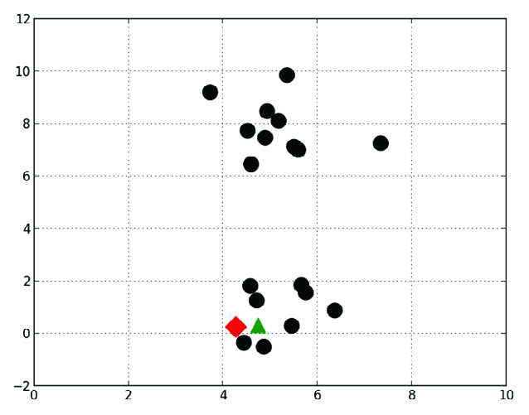
Local Optima
K-means often initializes the centroids to the positions of randomly selected observations.
Sometimes, it is unlucky and the centroids are set to positions that cause K-means to converge to a local optimum.
To avoid unlucky initialization, K-means is often repeated dozens or hundreds of times.
In each iteration, it is randomly initialized to different starting cluster positions.
The initialization that minimizes the cost function best is selected.

Slide 18
Selecting K with the Elbow Method
If k is not specified by the problem's context, the optimal number of clusters can be estimated using a technique called the elbow method.
The elbow method plots the value of the cost function produced by different values of k.
As k increases, the average distortion will decrease; each cluster will have fewer constituent instances, and the instances will be closer to their respective centroids.
However, the improvements to the average dispersion will decline as k increases.
The value of k at which the improvement to the dispersion declines the most is called the elbow.

Slide 19
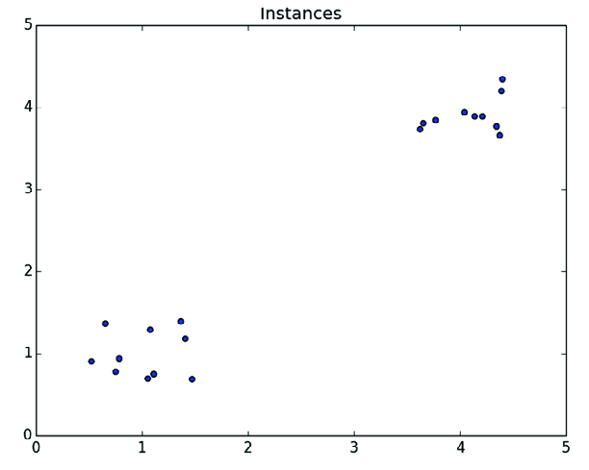
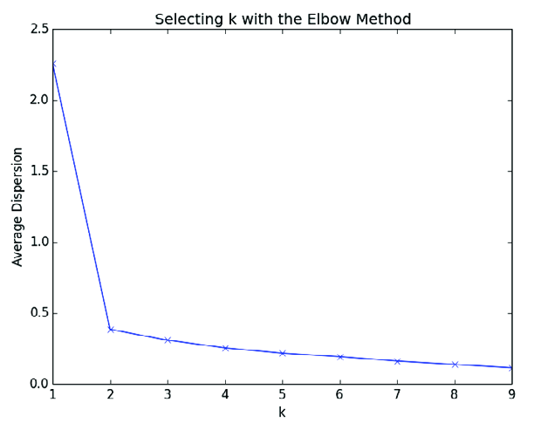
Two Clusters (k = 2)

Slide 20
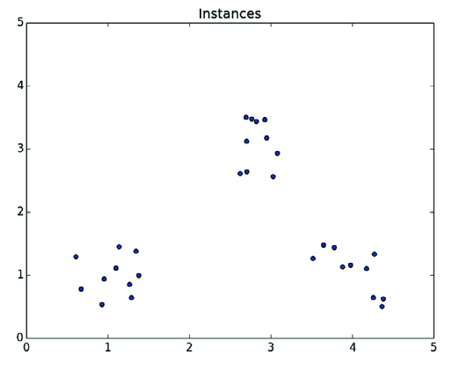
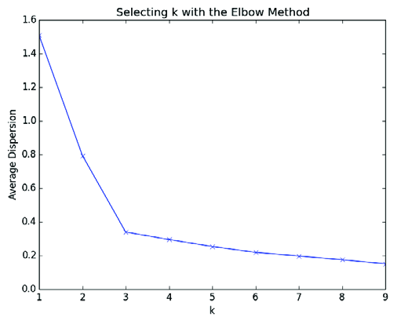
Three Clusters (k = 3)

Slide 21
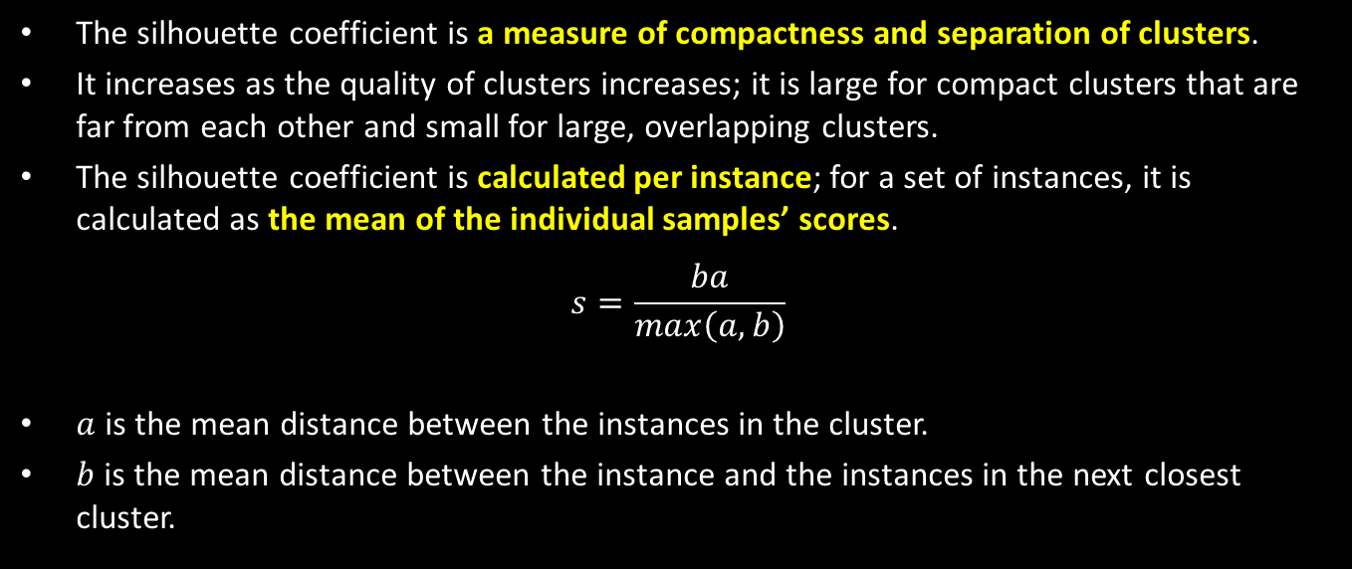
Evaluating Clusters
The silhouette coefficient is a measure of compactness and separation of clusters.
It increases as the quality of clusters increases; it is large for compact clusters that are far from each other and small for large, overlapping clusters.
The silhouette coefficient is calculated per instance; for a set of instances, it is calculated as the mean of the individual samples’ scores.
$$s=\frac{ba}{max\left(a,b\right)}$$
$a$ is the mean distance between the instances in the cluster.
$b$ is the mean distance between the instance and the instances in the next closest cluster.

Slide 22

Let’s See How K-Means Works

Slide 23
Homeworks
Practice all K-Means computer programs in the book and collect them via LMS.

Slide 24
Thank You for Today
Always Keep Your Spirit!

